Slide 1
SCIENCE
With Mr. Tsoukalis

Slide 2
Anatomy and Physiology
Study Skills
Learning Process
Scientific Content

Slide 3
AP Environmental Science (APES)
Study Skills
Learning Process
Scientific Content
AP Exam

Slide 4
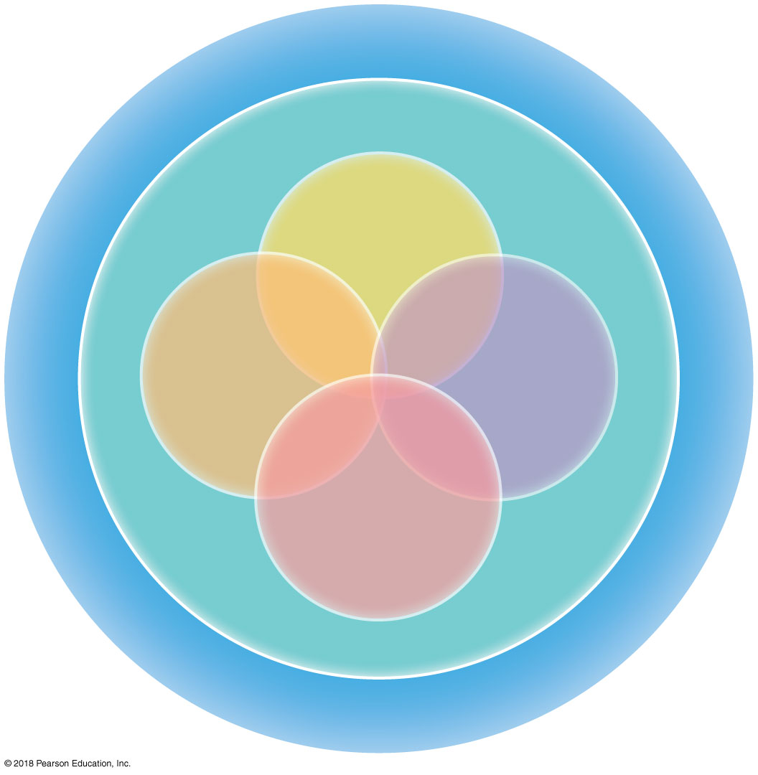
Figure 1–1 A Conceptual Framework for Learning.
Applying and
describing
In Class,
Labs, Case Studies, Discussions,
Ultimate Goal
Before Class,
Textbook Reading,
Background
Synthesizing
and
creating
Analyzing
and
explaining
Evaluating
and measuring

Slide 5
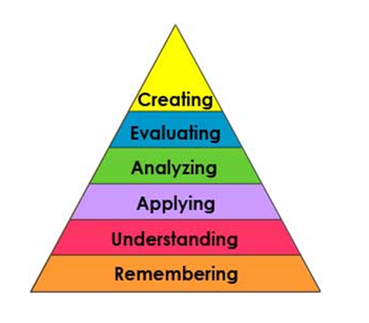
Levels of thinking Bloom’s Taxonomy
- In Class
- Labs, Cases Studies and
Discussions
- Before Class
- Textbook Reading
Benjamin S. Bloom 1984. Taxonomy of educational objectives. Allyn and Bacon, publ. Copyright Pearson Education. Anderson& Krathwohl, 2001

Slide 6
Average retention after 24 hours
X
Lecture 5%
Reading 10%
Student Home Before
Audiovisual 20%
Students/Teacher In-Class
Demonstration 30%
Discussion Group 50%
Practice by Doing 75%
Teach others / Immediate use of Learning 90%
From Dale, E. 1954. “Audio-Visual Methods in Teaching”. The Dryden Press, NY.

Slide 7
Why aren’t you going to “teach” me?
Research has shown that we learn when (and experience):
our prior knowledge is challenged
we figure out what we know and don’t know
we engage in problems/activities that help us build our skills
we work in groups – no matter what your role

Slide 8
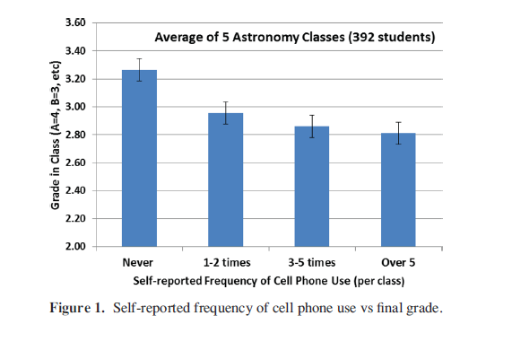
Don’t get distracted
Average grade difference between cell phone use and none: 0.36 ± 0.08
This is a third of a letter grade (e.g. B vs. B+)
Source: Duncan et al., 2012. In Astronomy Education Review.

Slide 9
APES Dual Credit
Camden County College
BIO106 - Living in the Environment
2 Methods
High School Plus Program | AP Test Only
Get B in course, plus 3 on APES Exam | Get 4 or 5 – Get credits
AP Exam Cost and HSPP Cost | AP Exam Cost Only

Slide 10
A&P Dual Credit
Camden County College and Rowan College of New Jersey
CCC | RCGC
Get B in course | Get B in course
BIO103 – Human Biology | BIO105 – A&P I
3 credits | 4 credits
$150, HSPP fee | $ 125

